Slide 1
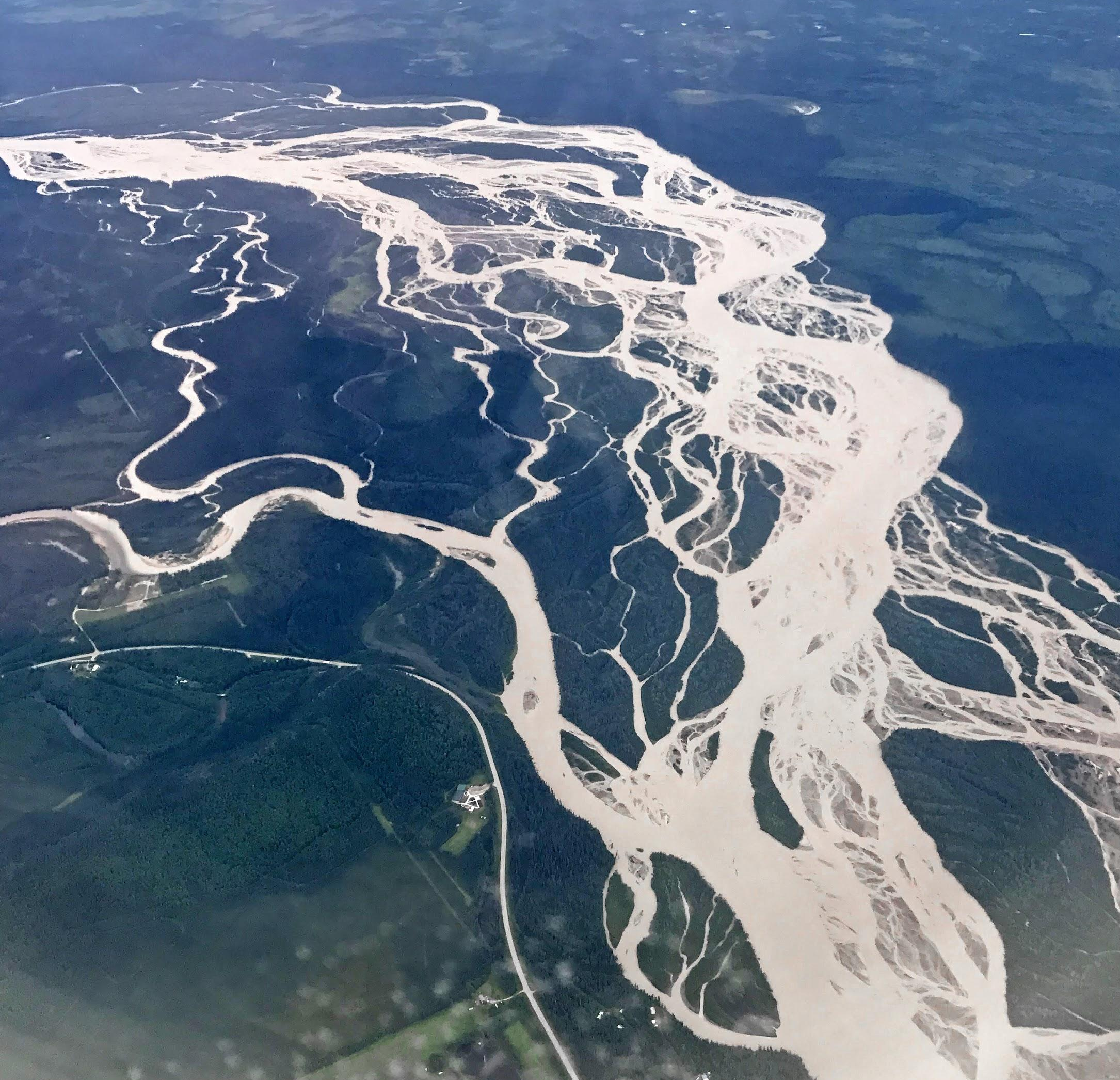
Observed and Modeled Streamflow Response to Hydroclimatic Changes in Alaska
Dylan Blaskey
Department of Civil Engineering
University of Colorado Boulder

Slide 2

Acknowledgements
Dr. Keith Musselman, University of Colorado Boulder
Dr. Michael Gooseff, University of Colorado Boulder
Dr. Josh Koch, USGS
Yifan Cheng, National Center for Atmospheric Research
Andy Newman, National Center for Atmospheric Research
The Indigenous Advisory Council
Funding: NSF Navigating the New Arctic

Slide 3
Project Goals
1.
What discharge record is need to understand long term trends?
2.
How has river discharge changed within the observational record?
3.
What are the drivers of river discharge change?

Slide 4
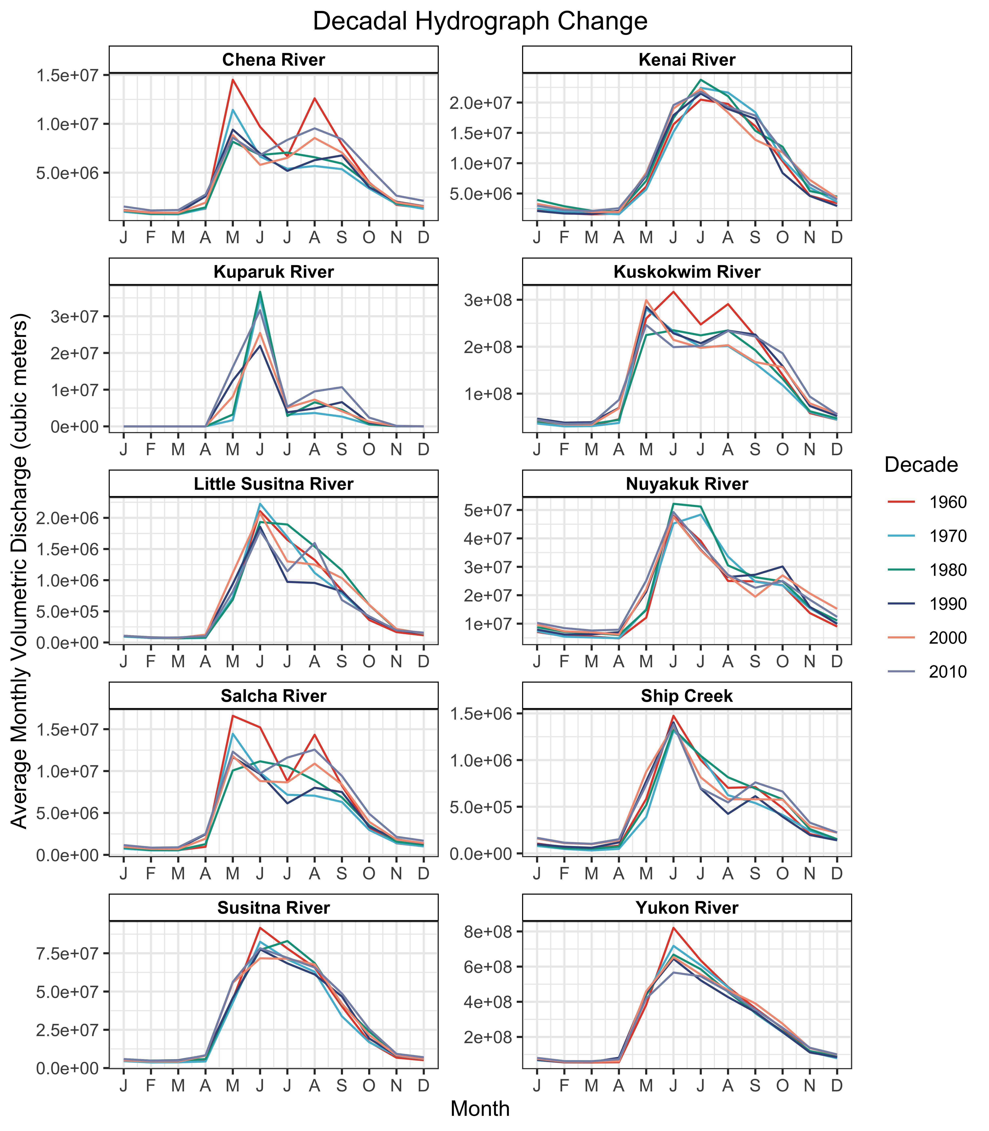
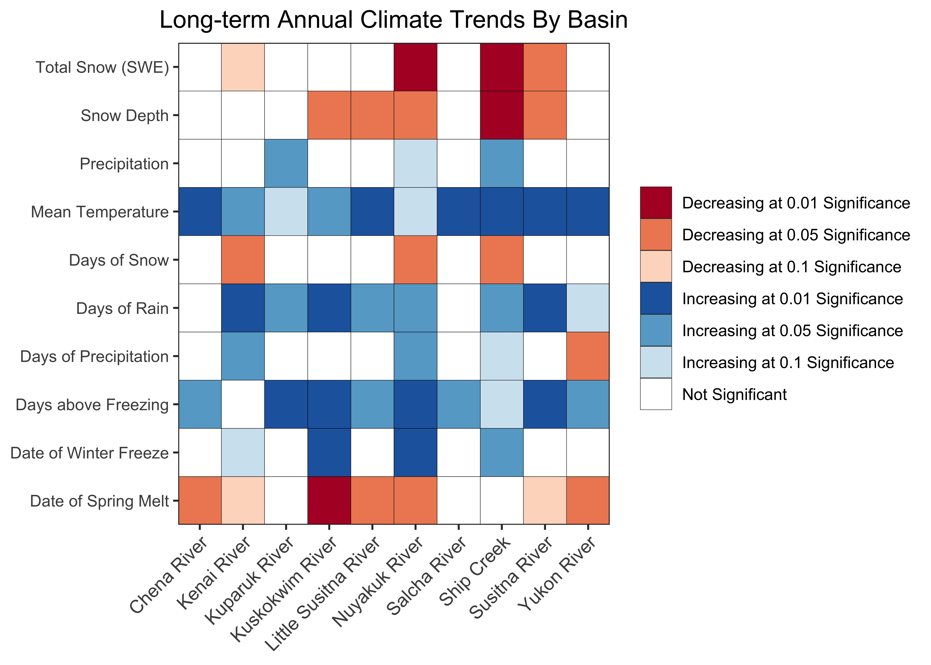
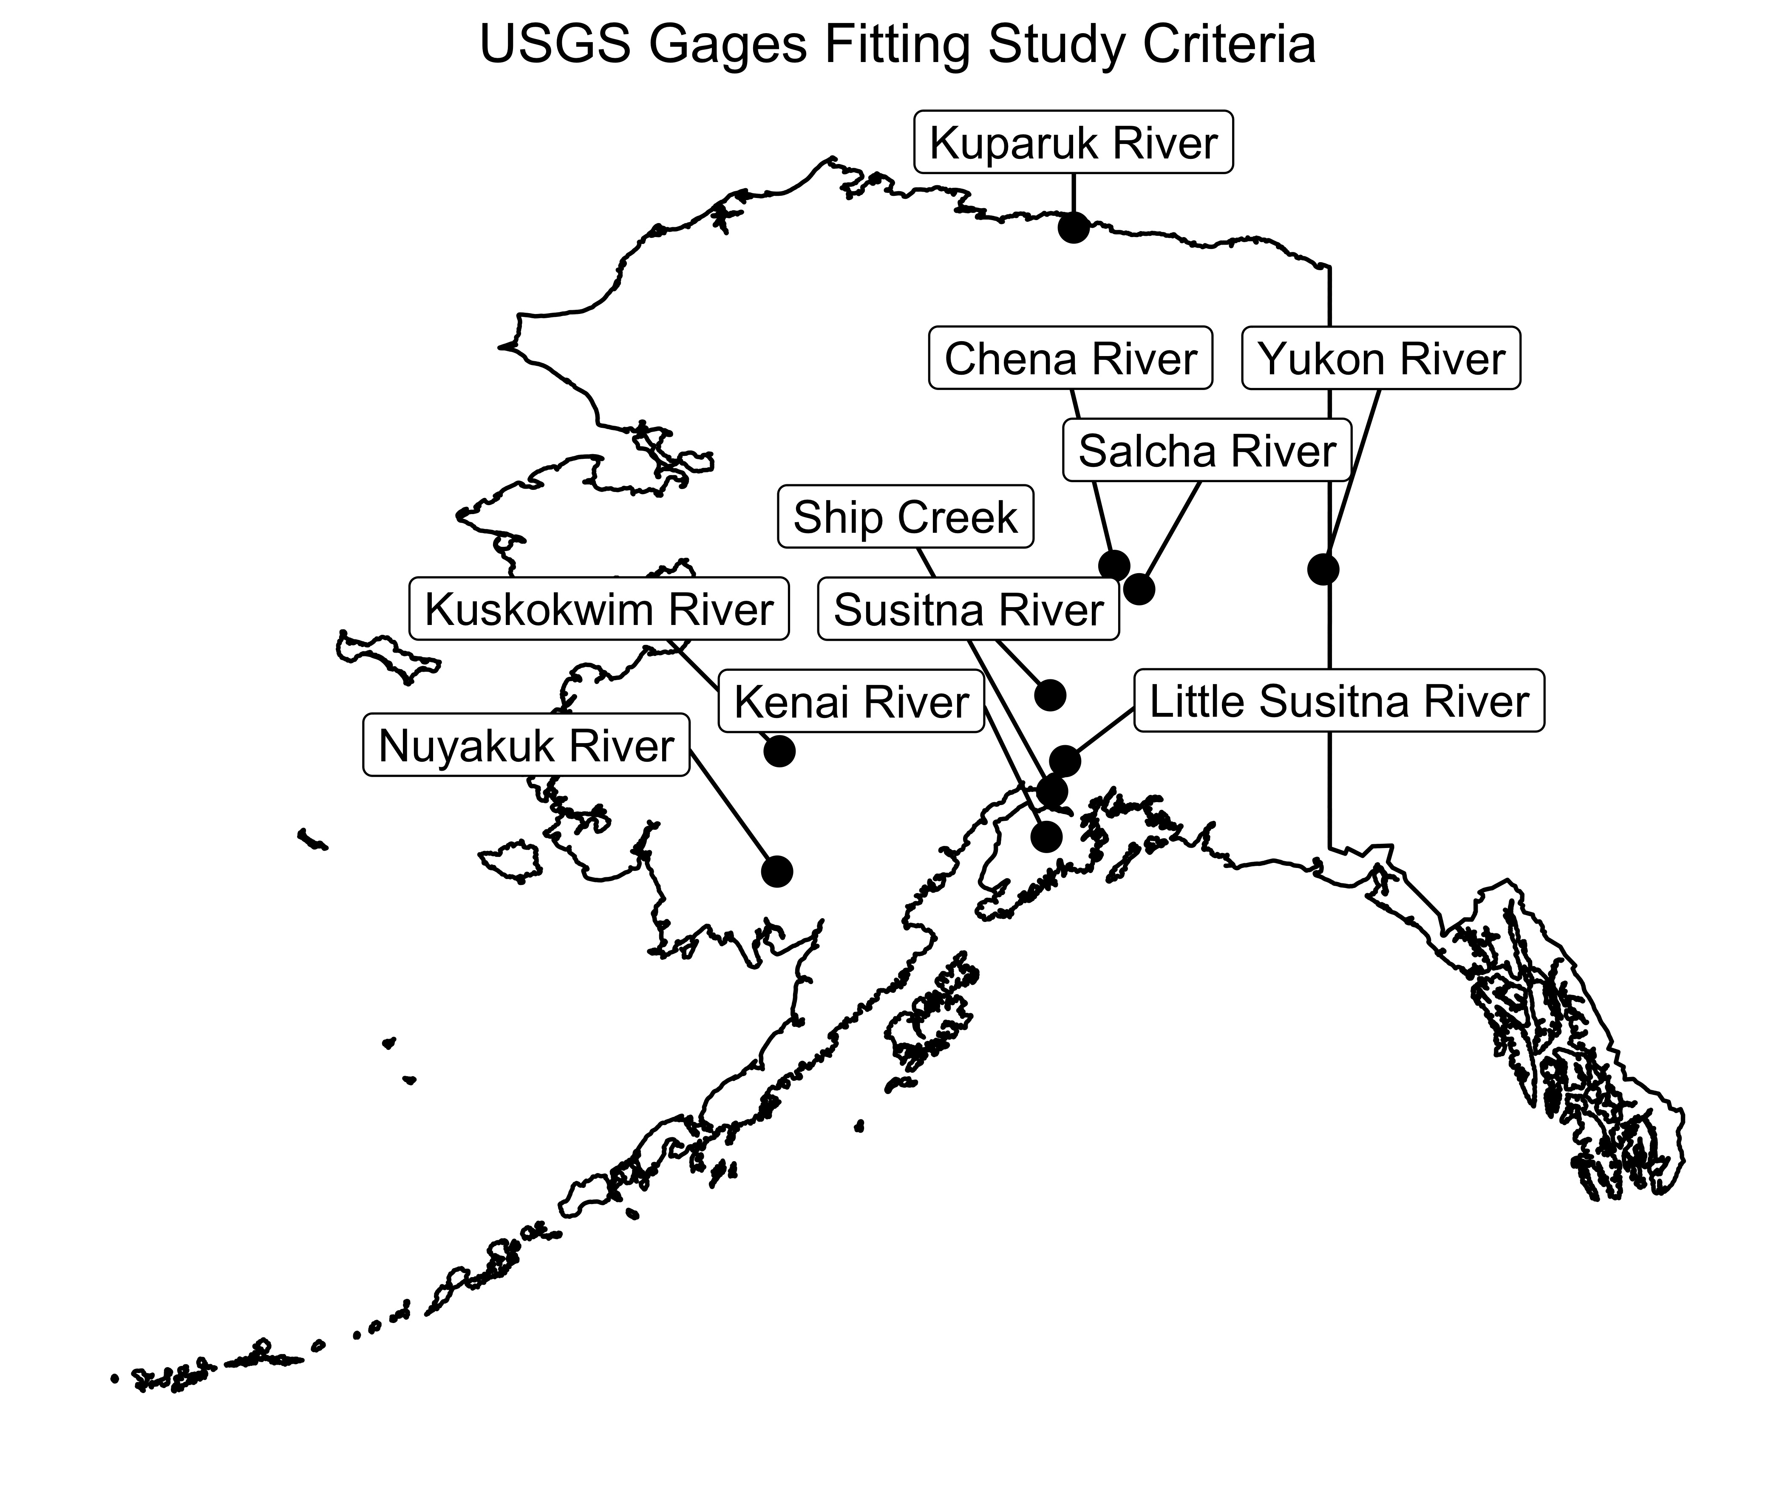
Changing Hydrograph Due to Changing Climate

Slide 5
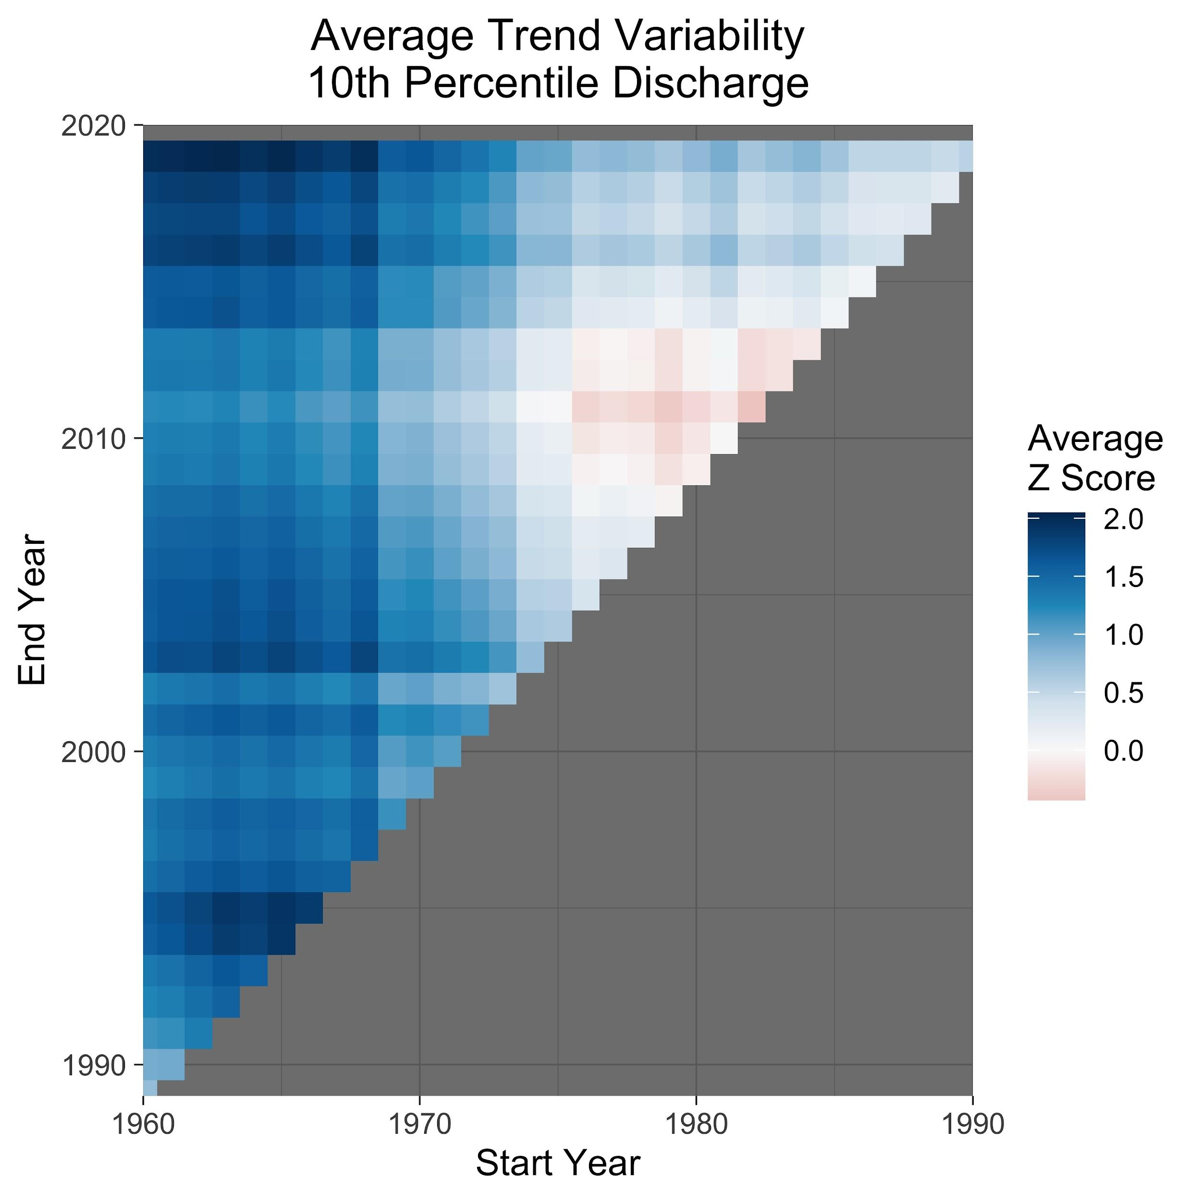
Climate Variability Makes Trend Analysis Difficult
Pre-whitened Mann-Kendall
Diagonals are the same length in record
Vertical keeps the same start year
Significant Positive Trend
Horizontal keeps the same end year
Not Significant Trend

Slide 6
Climate Variability Makes Trend Analysis Difficult
Look for homogeneity in color for record length
30-year record too variable
>40 is better
Note: Fewer data points to test variability in longer records
>50 Years
40-50 Years
30-40 Years

Slide 7
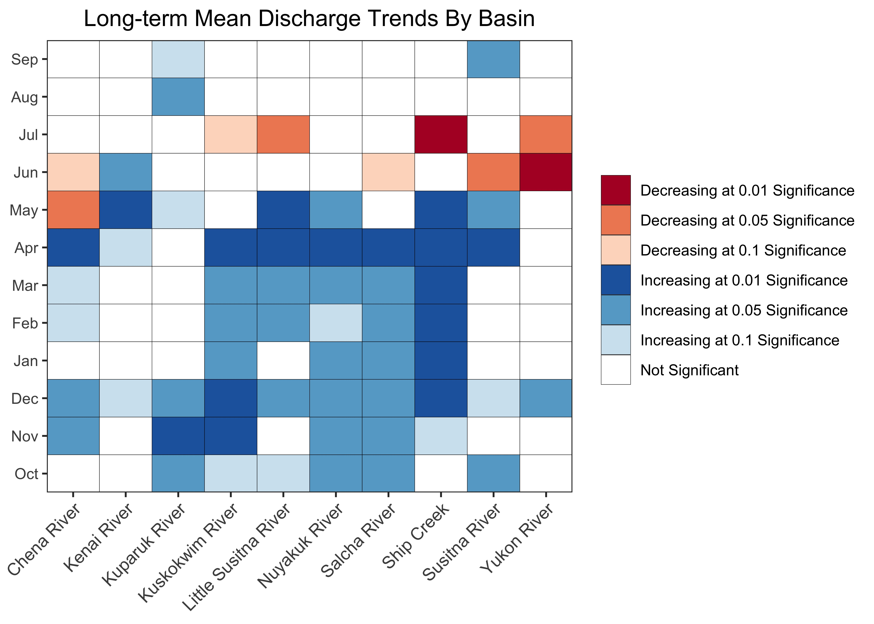
October – May Discharge Is Increasing Across Alaska

Slide 8
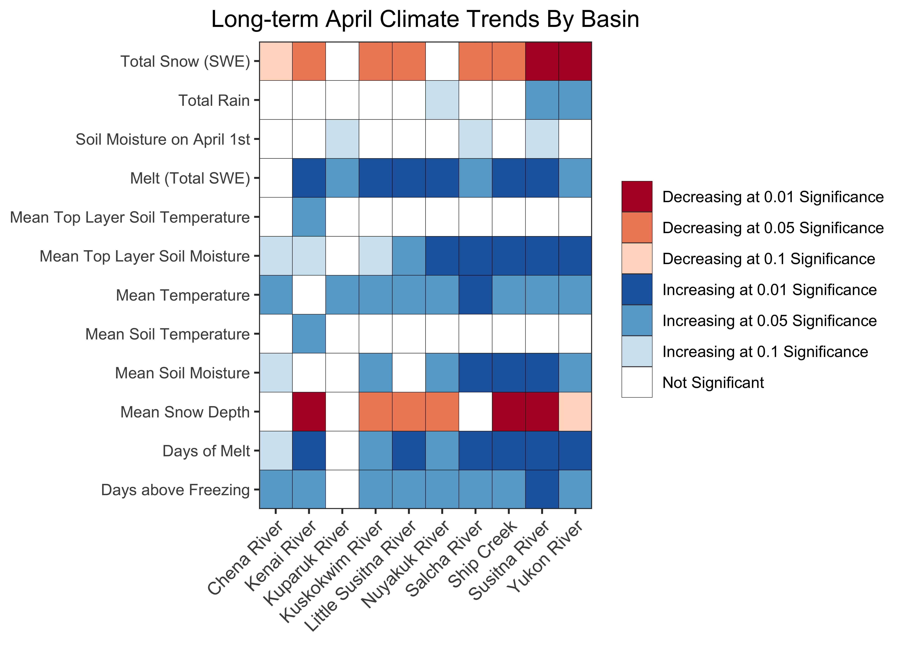
April Climate is Changing Rapidly
Notes:
Make y-axis by 2s, group type of analysis

Slide 9
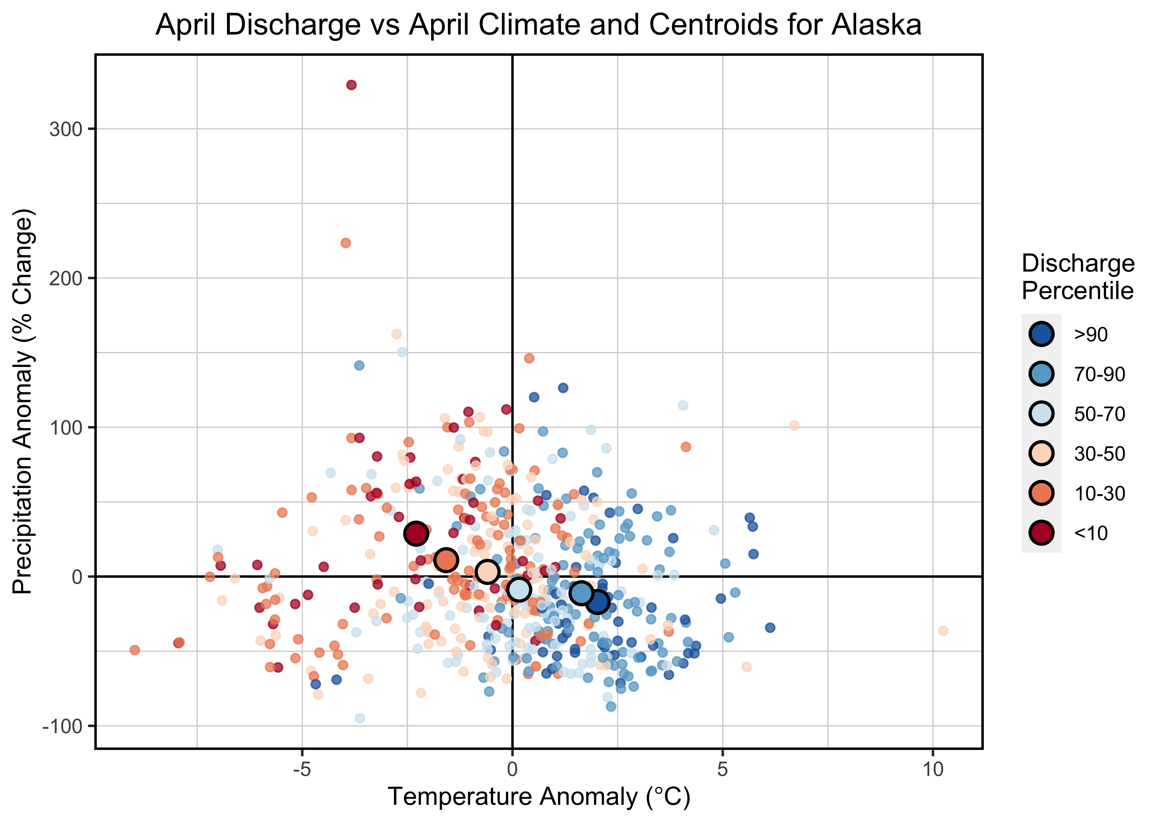
April Discharge Drive by Temperature + Precipitation

Slide 10
Conclusions
1.
Longer term records (≥50 years) are needed to understand trends
2.
Cold season (Nov-Apr) discharge is increasing across Alaska
3.
Temperature increase during this time (especially in Apr) cause higher discharge

Slide 11
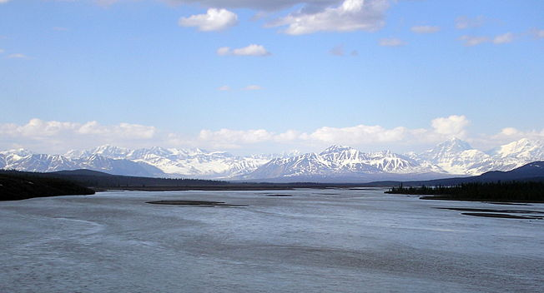



Connect with Me
dblaskey
@DBlaskey
dylan.blaskey@colorado.edu

Slide 12
Workflow
Clean
Visualize
Analyze
Download from USGS
Remove incomplete data
Group by decade and graph discharge
Plot trend stability
Changing high and low flows
Seasonal changes
Timing of peak

Slide 13
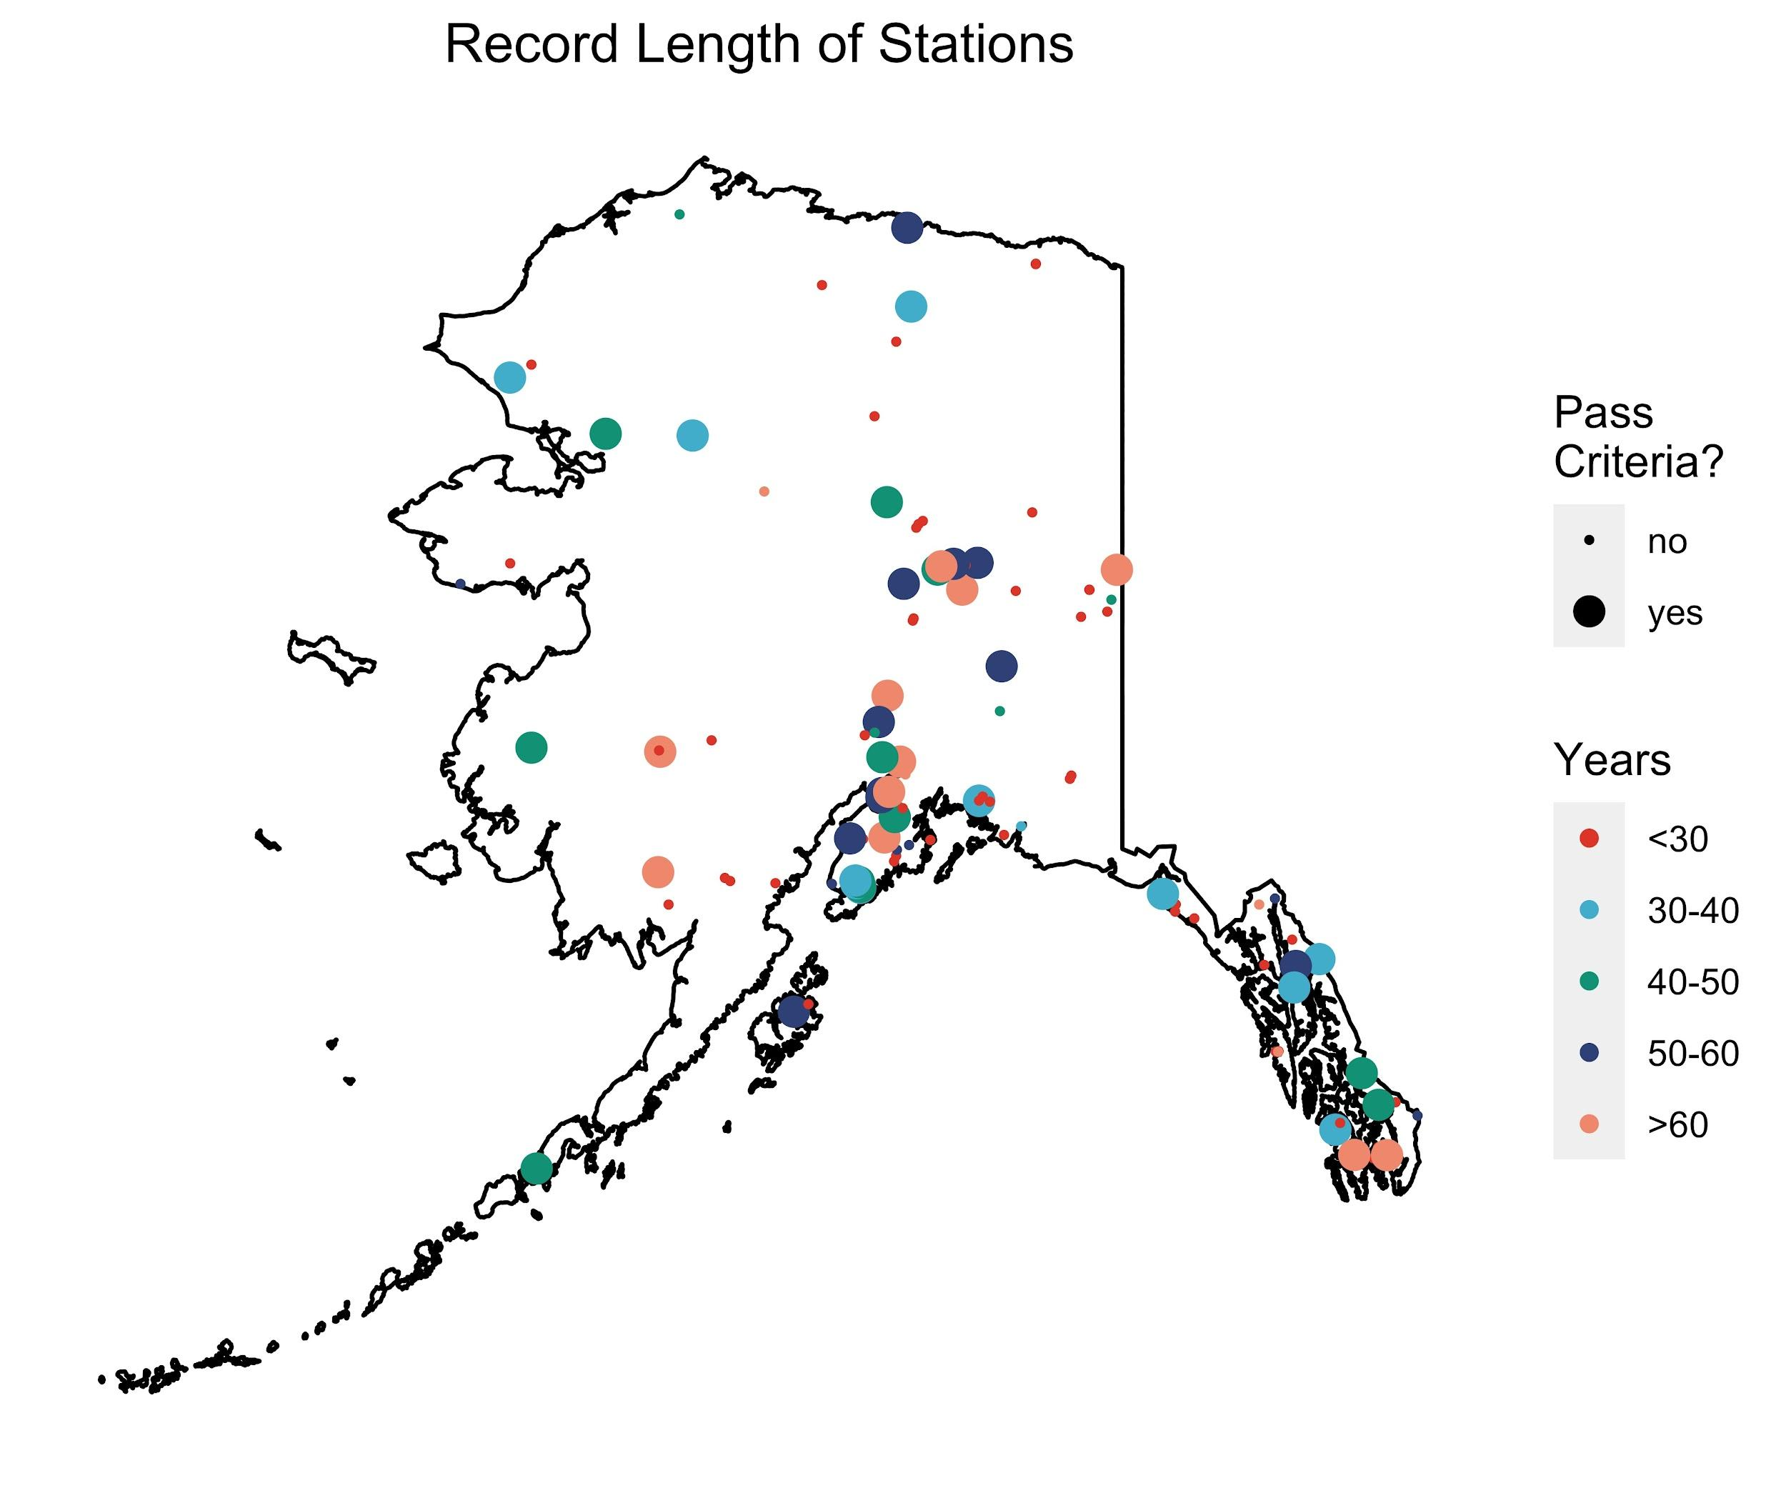
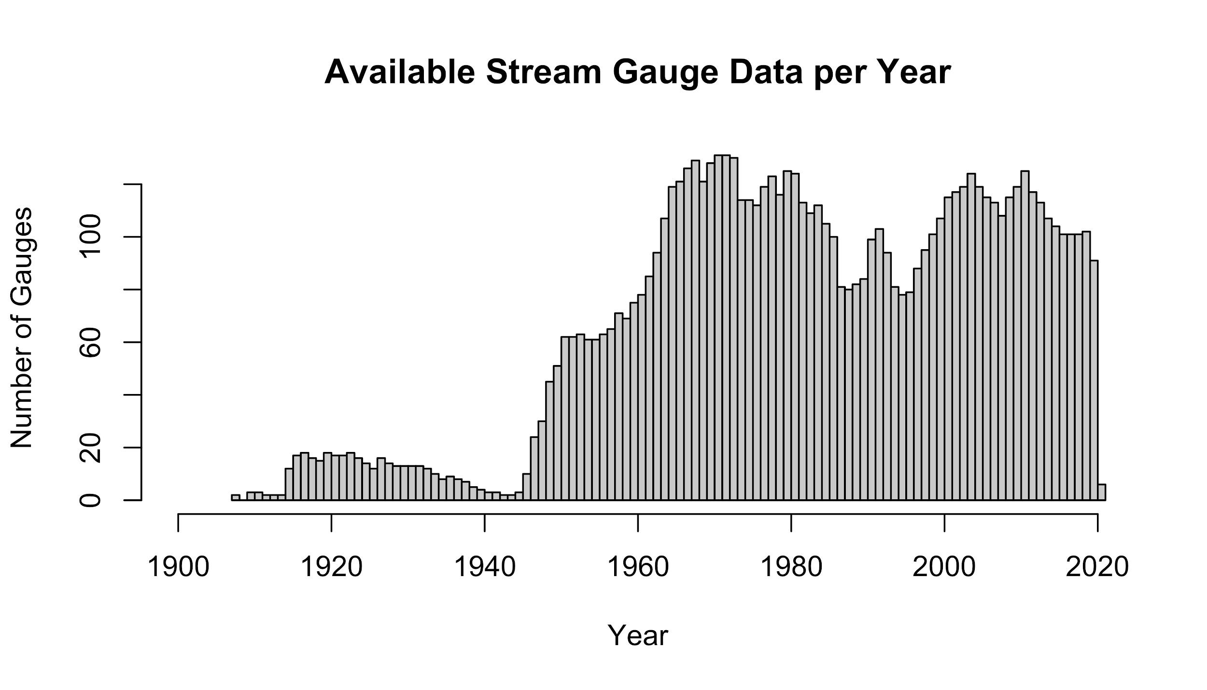
Data Availability
30 years: 40 gages
40 years: 26 gages
50 years: 19 gages
60 years: 10 gages

Slide 14
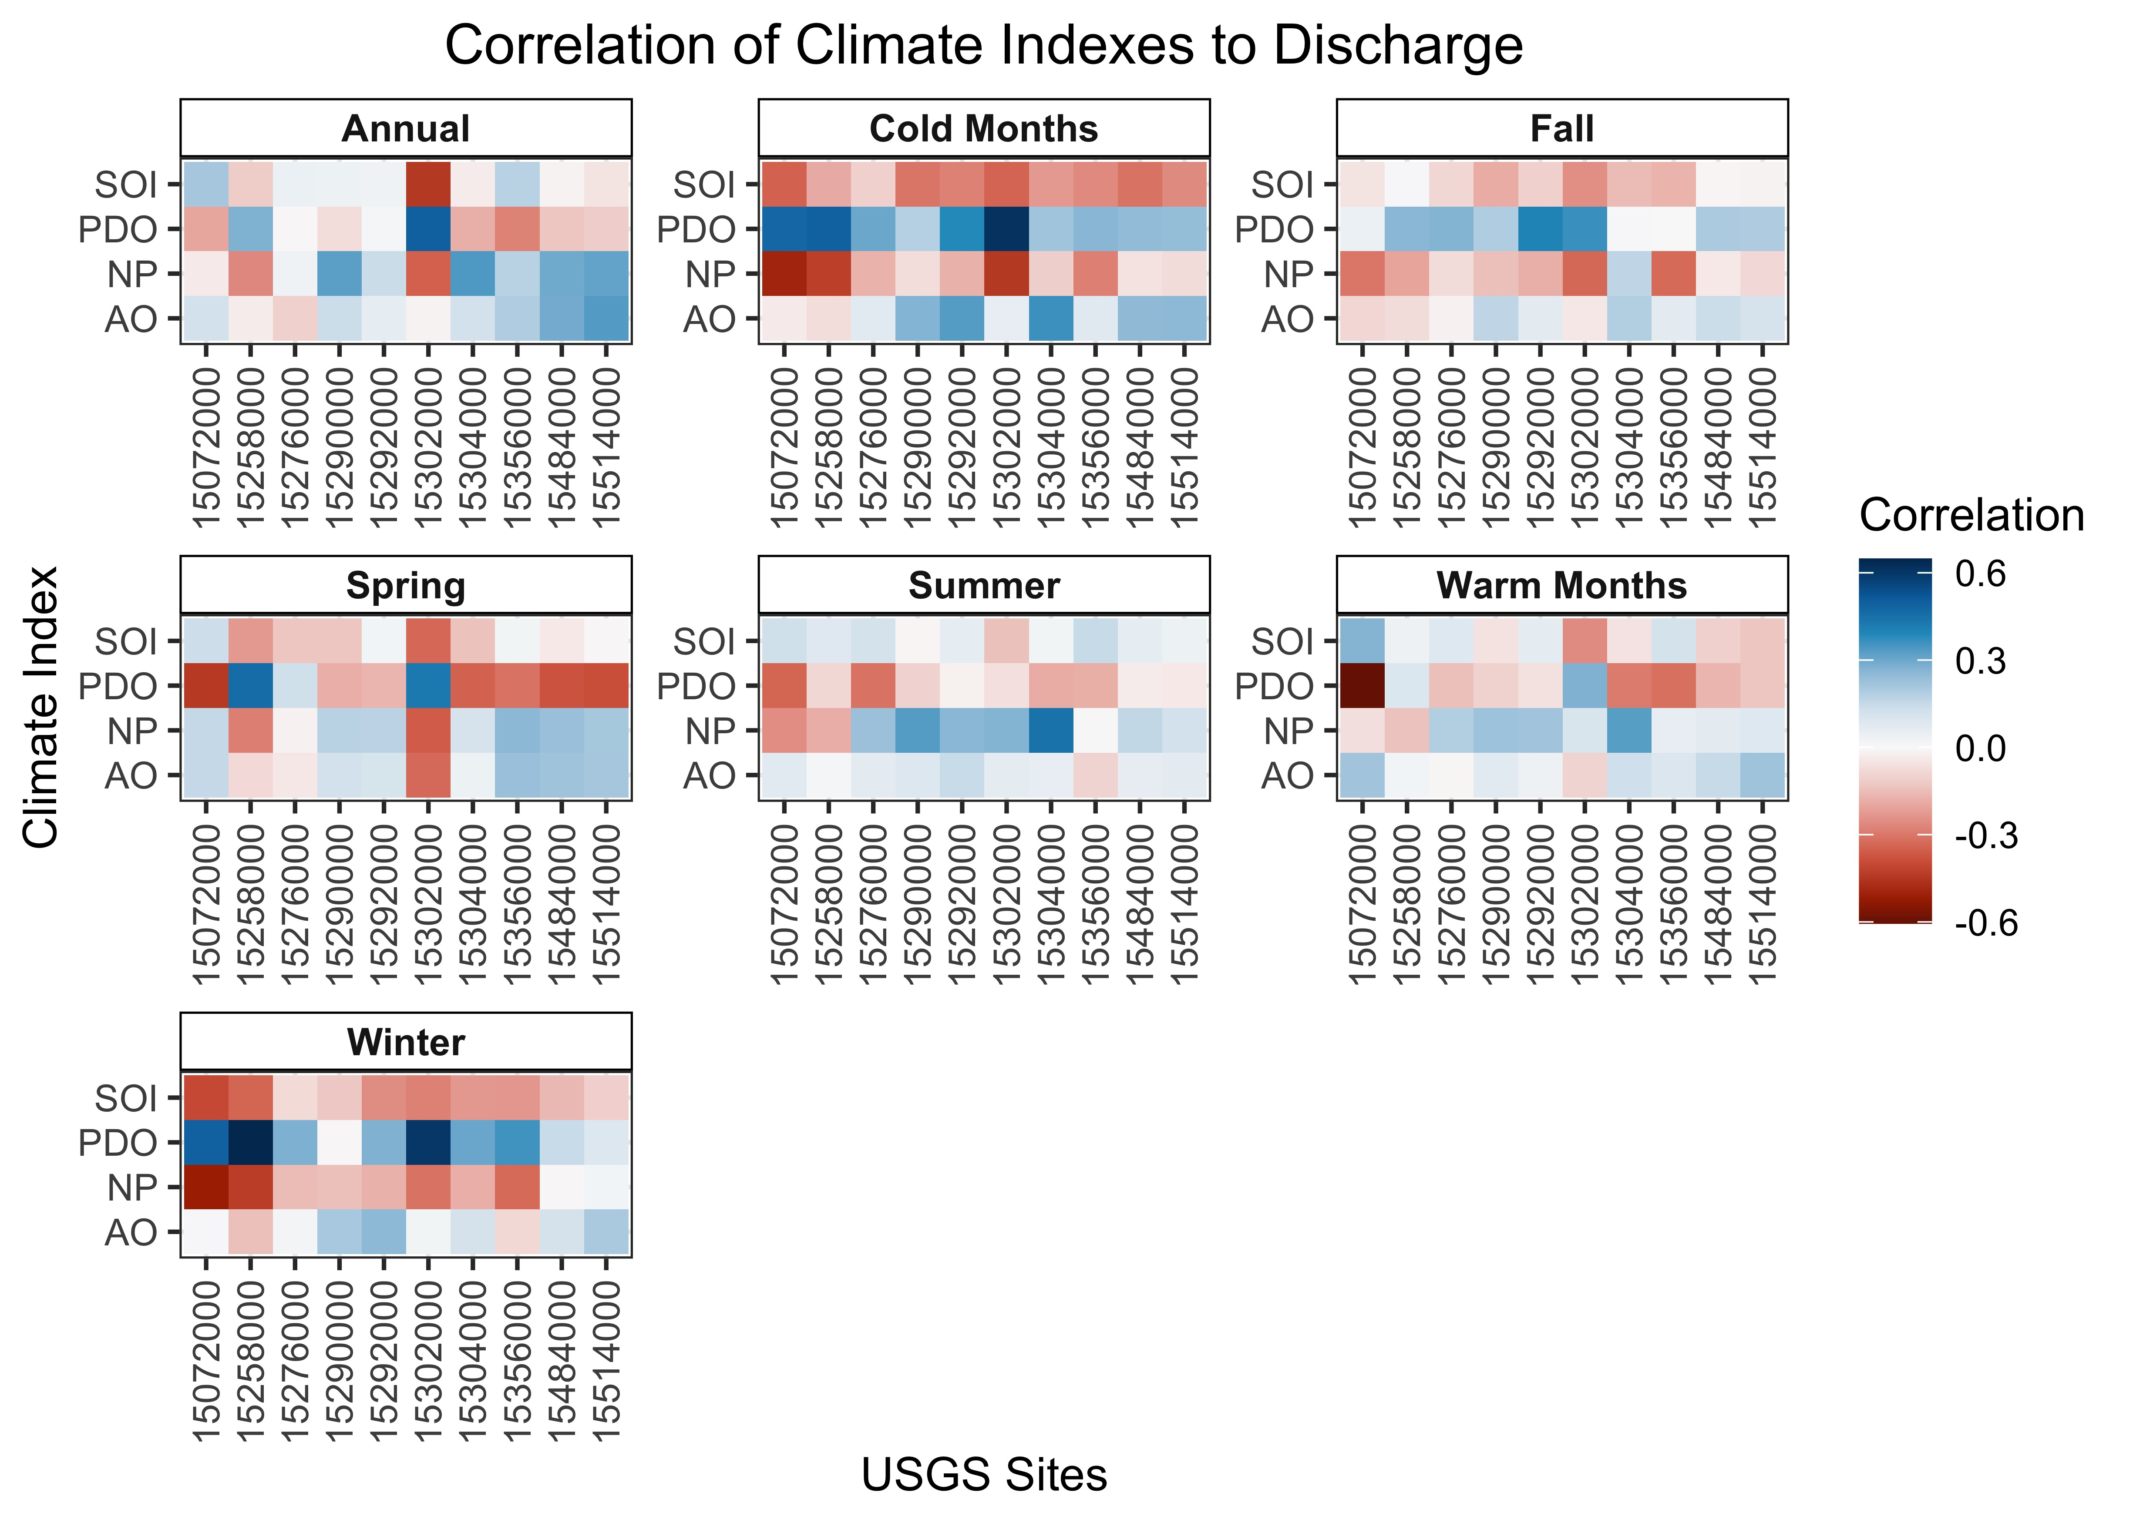
Some Variation in Discharge Due to Climate Fluctuations

